Slide 2
Introduction to the Pantanal Service Platform
Instructor: Li Xuankai, Software Architect, OPPO

Slide 3
Course intro - Course objectives
This course aims to walk developers through the fundamentals of the Pantanal Service Platform, including its background, core features, and the basics for the Pantanal service development.

Slide 4
1
Platform Overview
2
Platform Features
3
Service Overview

Slide 5
Part 1 / Platform Overview

Slide 6
Vision of the Pantanal Service Platform: Better understand needs of users and push services to users accurately and naturally at the right entries at the right time
Context awareness
User-centric services
Natural interaction
Understand user contexts better, providing direct access to services
Assemble and hand over services to create a one-stop user experience
Tailor interaction modes to suit users' scenes
Semantic recognition
Training data
Context
Hybrid context 3
Phone
Service x
Service information
Information hierarchy
Context recognition
Coherent context
Annotation
Hybrid context 1
Hybrid context 2
Assembly
Vehicle's display
Phone
Phone
Time
Location
Event
Environment
Device
Service 1
Service 2
Service 2’
(2 + x)
Service 4
Multiple devices and
touchpoints
Select any interaction mode
Wi-Fi
Bluetooth
Gyroscope
Accelerometer
Handover
Sensors
User experience first
Vehicle's display
Camera
Fitness sensor
...
Interaction devices
Phone's home screen
Phone's status bar
Watch
Earphones
(Voice mode)
Vehicle's display
(Both touch and VGUI modes supported)
Phone's AOD
Deliver a seamless and coherent service experience by combining information from various sensors while continuously detecting contextual relationships and evolving changes
Understand user needs, assemble and hand over services, intelligently select the most suitable device, and provide a highly personalized service experience
Manage information types and content in a layered and hierarchical manner and select the optimal touchpoints and interaction modes based on users' scenes

Slide 7
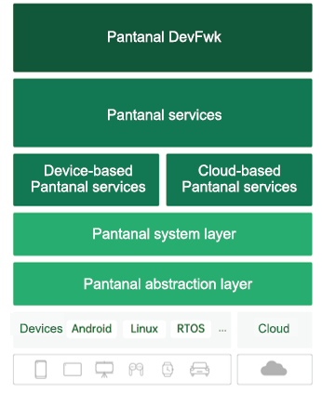
Positioning of the Pantanal Service Platform
Level 0 framework of the Pantanal System
(1) How does the Pantanal System relate to other operating systems?
The Pantanal System is designed as middleware that can work across a diverse range of operating systems and devices.
(2) How does the Pantanal Service Platform relate to the Pantanal System?
The Pantanal Service Platform is part of the Pantanal System, where apps can be developed, discovered, and run.
(3) How do Pantanal services relate to the Pantanal Service Platform?
Pantanal services are the apps that run on the Pantanal Service Platform and exhibit the following four features.

Slide 8
Overall architecture of the Pantanal Service Platform
UPK-specific functions
Service access:
DevStudio | DevLite | Orchestration tools
Extensive APIs
Integration with traditional app services (restricted functionality)
Device-cloud service governance:
ServHub
Registration | Discovery | Management
Integrated device-cloud engine
ServHub
Cloud-based service governance
Sync
Service information
Service packages
Static management
Runtime management
Cloud-based engine
Cloud
Service publishing
Query and handover
Device
Multiple types of services
Device-based service governance
UPK
EXE
APK
...
Static management
Native registration
Registration
Discovery
Package management
Runtime management
Multi-modal interaction
Context awareness
Integration tools
Call
Assembly
Handover
Enablement
DevStudio
Orchestration tools
...
Device-based engine
Service access
Service governance

Slide 9
Process view of the Pantanal Service Platform
UPK-specific functions
Device A
Cloud
Entry A
Entry B
Shadow
UPK
UPK
Runtime
Runtime
Device B
UPK
UMS
Runtime
Shadow
UMS
PIDL
Device C
UPK： Ubiquitous Package
UMS： Ubiquitous Manager System
PIDL： Pantanal Interface Definition Language
Runtime： Ubiquitous Package Runtime
Shadow： Ubiquitous Package Data
Runtime

Slide 10
Part 2 / Platform Features

Slide 11
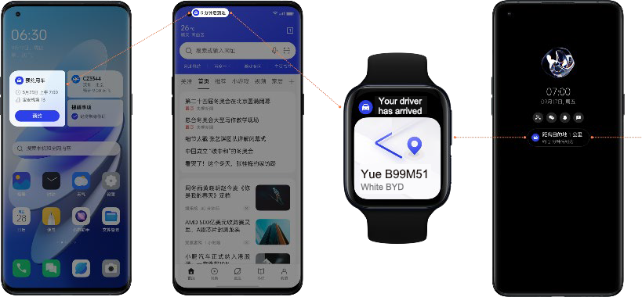
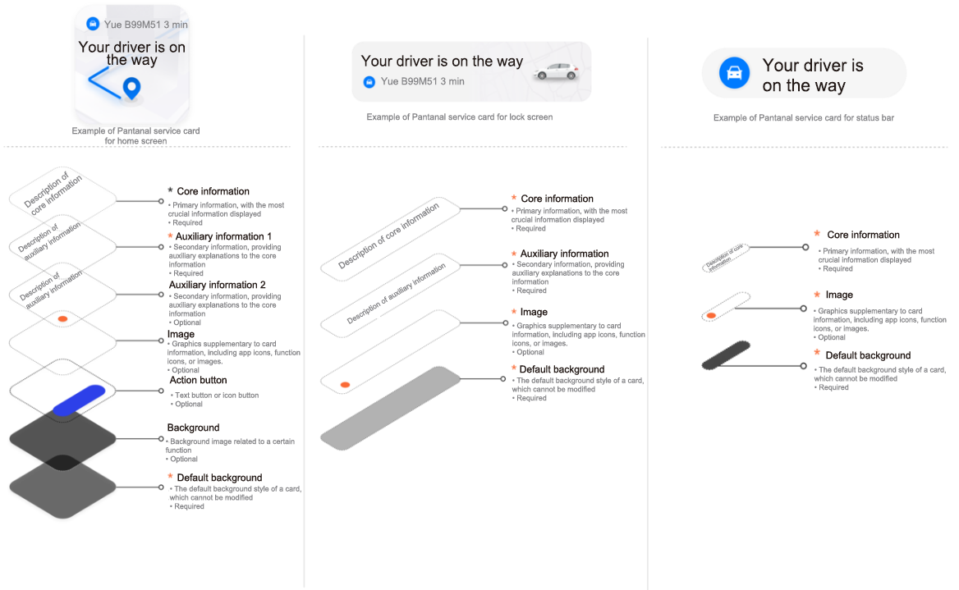
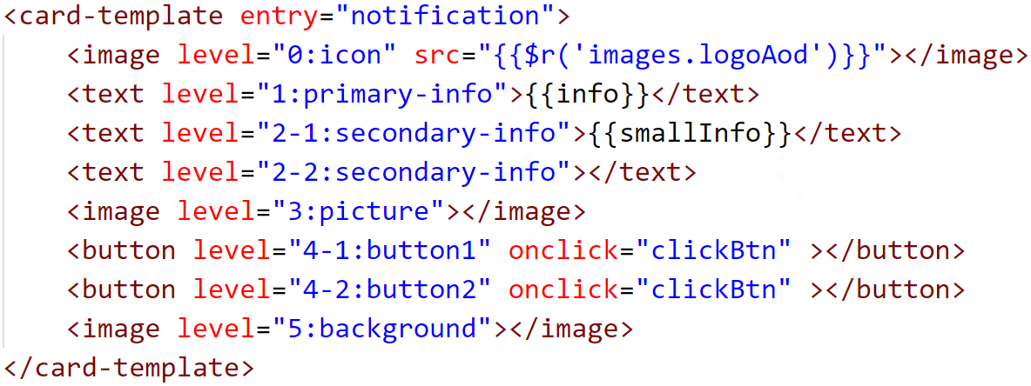
Features of the Pantanal Service Platform: Develop once for multiple entries
Real Effect
Service code:
UPK Develop
UI Template

Slide 12
Features of the Pantanal Service Platform: Context awareness
Continuously detects contextual relationships and evolving changes, offering accurate insights into user intents so as to recommend targeted services, hand over or assemble them, and select appropriate modes
Offers standard services for common intents and simplifies integration for developers through standardized interfaces
Format of detected intents
Fixed prefix
Domain
Action ID
Example: pantanal.intent.travel.CALL_TAXI
Detection of user intents across different scenarios, such as mobility and lifestyle services
Coherent
context
Context
Hybrid context 3
Hybrid context 1
Hybrid context 2
Service configuration
Time
Location
Event
Environment
Device
Wi-Fi
Bluetooth
Gyroscope
Accelerometer
Sensors
Vehicle's display
Camera
Fitness sensor
...
Service configuration
Real Effect
UPK Develop

Slide 13
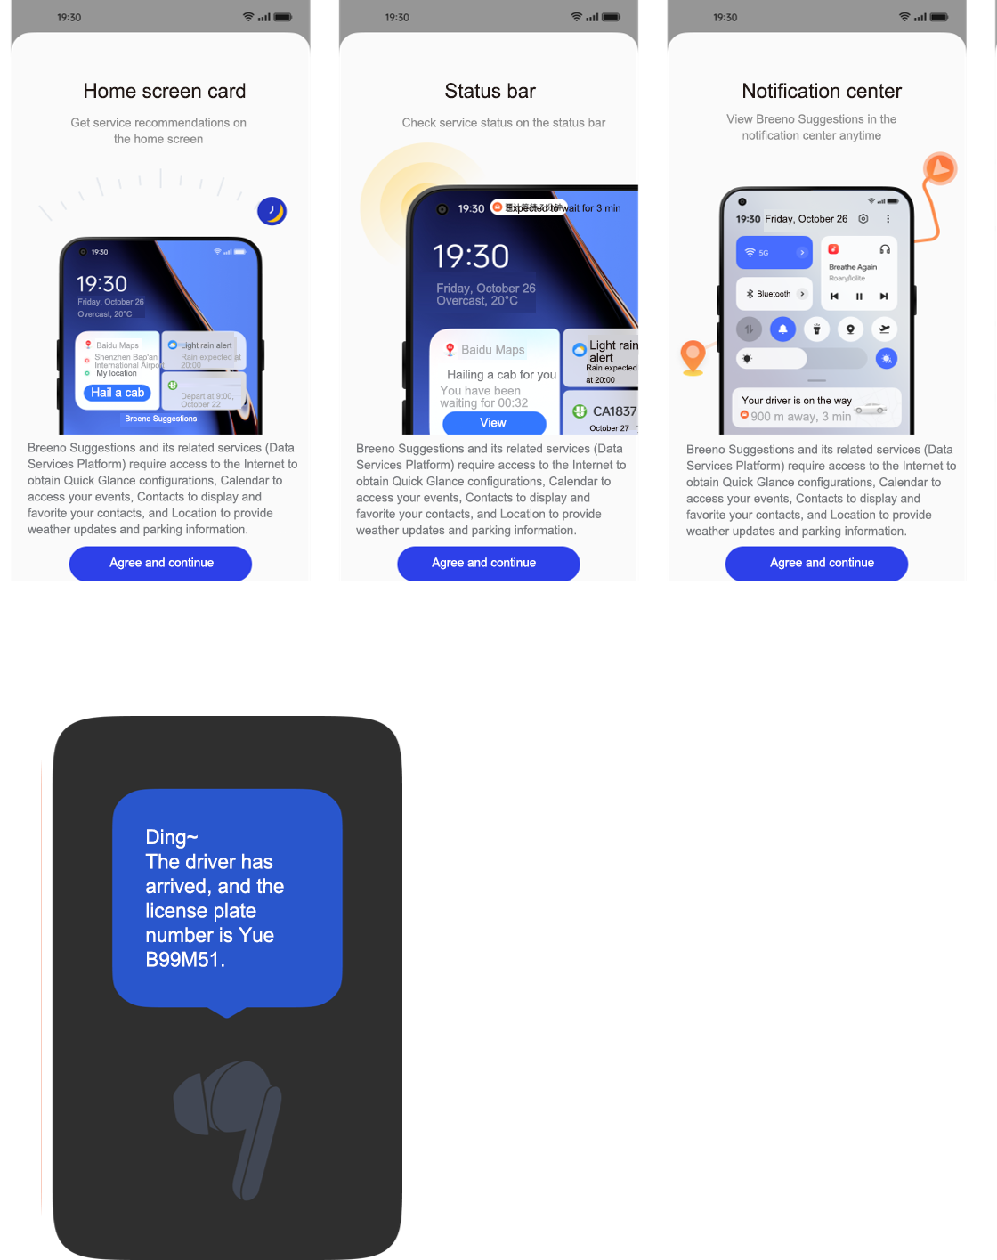
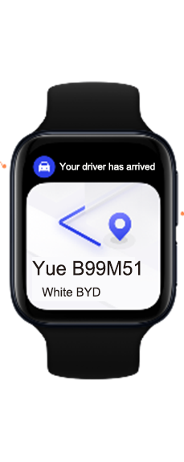
Features of the Pantanal Service Platform: Smart handover
UPK Develop
Phone
Handover coordination interface
Handover decision-making
Handover interface management
Handover engine
Coordination engine
Service ShadowData
Service data
Information at both ends of the handover
Service runtime constraints
Service permissions
Earphones
Real Effect
Watch
Design Description

Slide 14
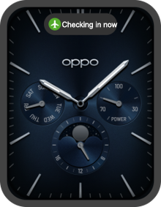
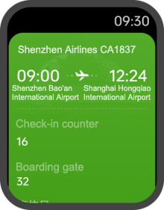
Features of the Pantanal Service Platform: Natural interaction
Personalized alert sounds
Gesture control
A wide variety of interactive gestures
Capsule
Card
Real Effect
Real Effect
Service code:
Service code:
UPK Develop
UPK Develop

Slide 15
Part 3 / Service Overview

Slide 16
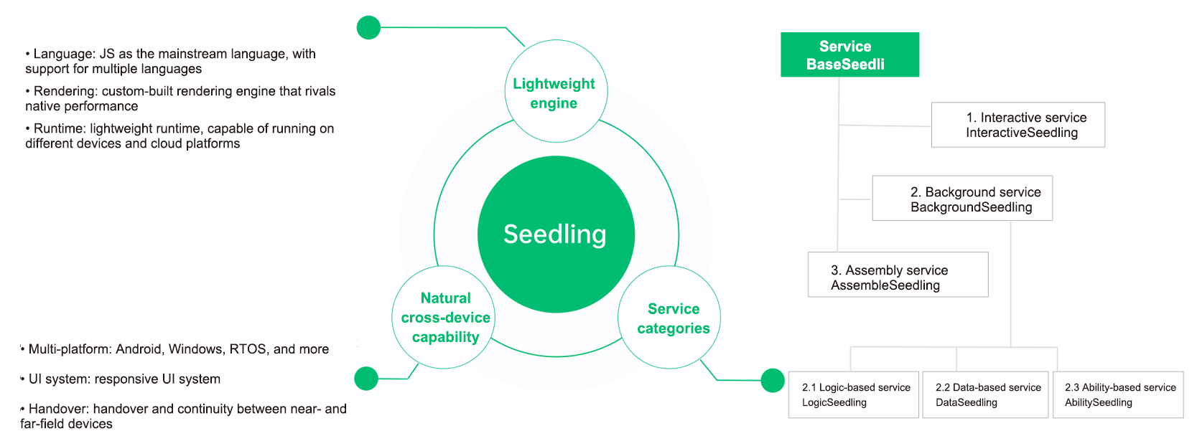
Basic service features

Slide 17
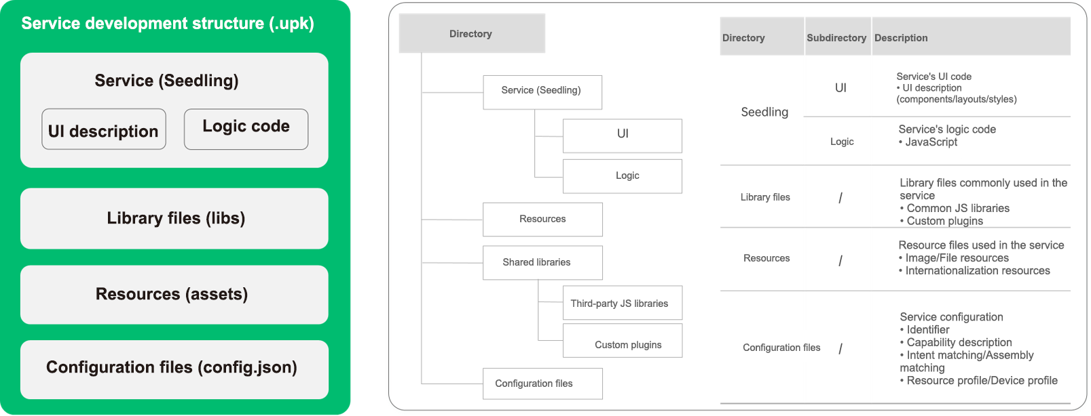
Service development directory

Slide 18
Service development framework
Development paradigms
Framework | Description
Development paradigms | Declarative programming paradigms Syntax of declarative UI description Semantics of Pantanal service features View/Logic/Data linking
UI components | Provide UI components UI components Multi-device adaptive layouts
Capability APIs | JavaScript Capability APIs Seedling lifecycle API Seedling feature API (assembly/handover/interaction) Capability call API
Declarative UI description
JavaScript syntax
View/Data model (MVVM)
UI components
JavaScript APIs
Basic components
Custom components
Lifecycle
Pantanal feature
Capability call

Slide 19
Service development process which provides developers with everything they need, from service development to service launch
Guideline documents/ Developer tools
Service development/ debugging
Service packaging/signing
Service launch/ review/distribution
OPPO Developers
DevStudio
DevLite
(Coming soon)
ServHub (Coming soon)

Slide 20
Together, we break boundaries

