Slide 2
Introduction to Pantanal DevKit
Instructor: Zhao Qiang, Senior System Engineer, OPPO

Slide 3
Course intro - Course objectives
This course aims to walk developers through what Pantanal DevKit is and what incredible possibilities it unlocks.

Slide 4
1
Overview
2
Development Framework
3
Development Tools

Slide 5
Part 1 / Overview

Slide 6
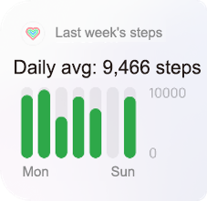
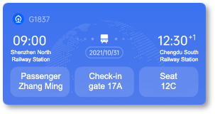
Overview of Pantanal DevKit
Service types
Home screen cards
Notifications/Capsules (Status bar/Lock screen/AOD)
Service development tools
Pantanal DevStudio
Pantanal DevLite
Pantanal DevFwk
Development paradigms
Development paradigms
UI components
APIs

Slide 7
One-stop service development platform
which provides developers with everything they need, from service development to service launch
Guideline documents/ Developer tools
Service development/ debugging
Service packaging/signing
Service launch/ review/distribution
OPPO Developers
DevStudio DevLite
ServHub

Slide 8
Part 2 / Development Framework

Slide 9
Service development framework
Development paradigms
Framework | Description
Development paradigms | Declarative programming paradigms Syntax of declarative UI description Semantics of Pantanal service features View/Logic/Data linking
UI components | Provide UI components UI components Multi-device adaptive layouts
Capability APIs | JavaScript Capability APIs Seedling lifecycle API Seedling feature API (assembly/handover/interaction) Capability call API
Declarative UI description
JavaScript syntax
View/Data model (MVVM)
UI components
JavaScript APIs
Basic components
Custom components
Lifecycle
Pantanal feature
Capability call

Slide 10
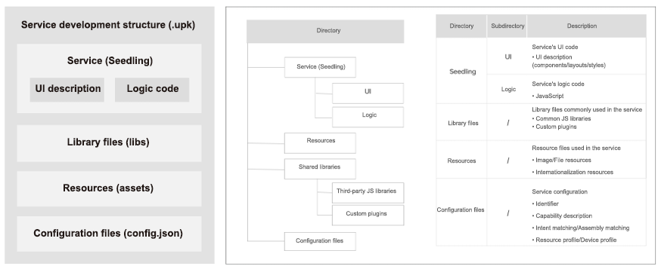
Service development framework - Service development directory

Slide 11
Service development framework - Service development paradigm
Template
Data
Function | Description
Data linking | Data-view linking Data drives UI changes
Event linking | Logic-event linking Event triggers JS logic
Style definition | Custom styles Subsets of CSS Adaptive layouts
JS API call | JavaScript APIs Lifecycle callback handling Service handover, assembly, and multi-modal interaction Capability API call
<template>
<div class="demo">
<text id="myTxt">{{myText}}</text>
<button onclick="btnOnClick" value="{{btnText}}" >
</div>
</template>
<data>
{
“uiData”:{
"btnText"："This is a button",
"myText" ："My Text"
}
}
<data>
Style
Logic
<script>
export default {
btnOnClick() {
this.setData （{btnText : "New Text"})
var data = storage.get("keyId")
},
onCreate() {
…
},
onXxx() {
…
}
} </script>
<style>
@media （aspect-ratio: 1*2） {
.demo {
flex-direction: row;
flex-grow:1;
}
}
</style>
Data linking
Event linking
Style definition
JS API call

Slide 12
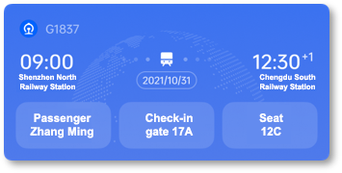
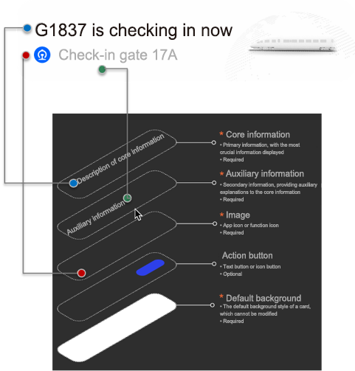
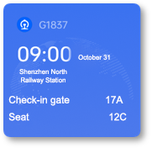
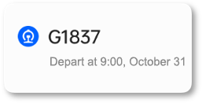
Service development framework - Card development paradigm
Custom templates (for the home screen/Shelf and other entries)
Fixed templates: follow information hierarchy standards and fill in the data required
Large card (4x2)
Medium card (2x2)
Core information
Auxiliary information
Small card (2x1)
Image

Slide 13
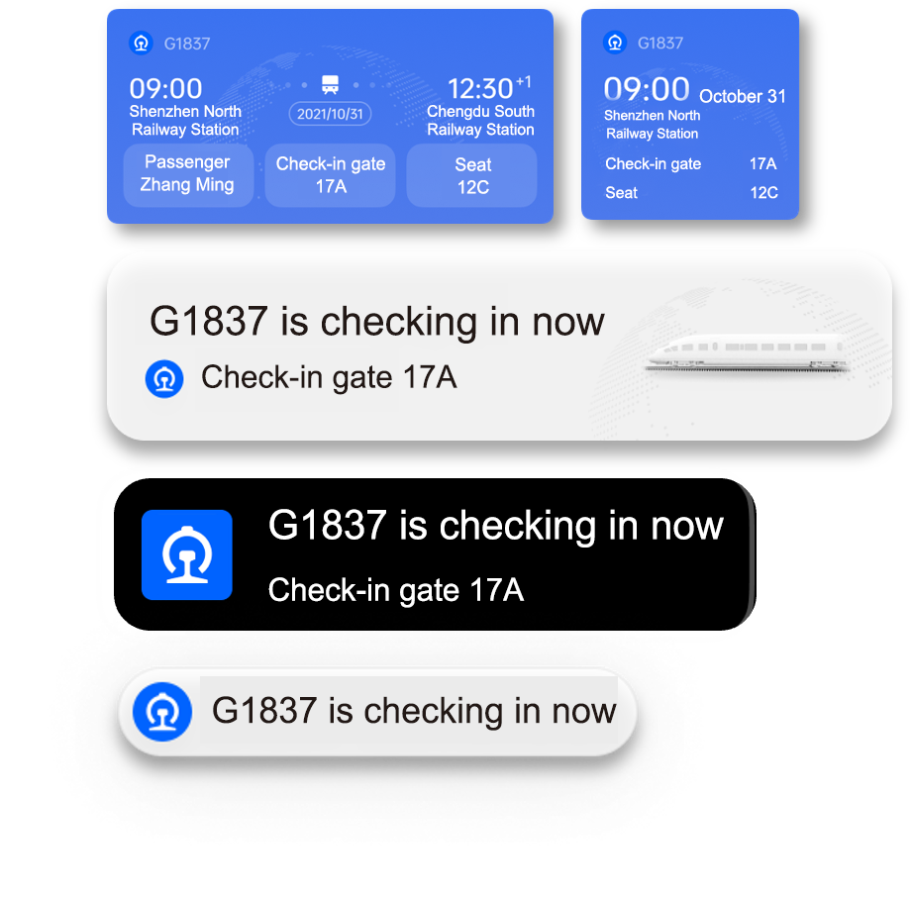
Service development framework
Develop once for multiple entries across devices
Write code
Display on a variety of phone entries
<card-template entry="notification">
<image level="0:icon" src="{{ $r('images.logo') }}"></image>
<text level="1:primary-info">{{ numberValue }}</text>
<text level="2:secondary-info">{{ title }}</text>
</card-template>
<card-template entry="desktop">
<div class="container">
<text>...</text>
<button>…</button>
</div>
…
</card-template>
Home screen/Shelf
Notification bar/Lock screen
Always On Display (AOD)
Status bar
Register an intent
"intent": {
"action": [ "com.oplus.seedling.demo.action.train" ],
"domain": "travel"
}
Voice announcements over earphones

Slide 14
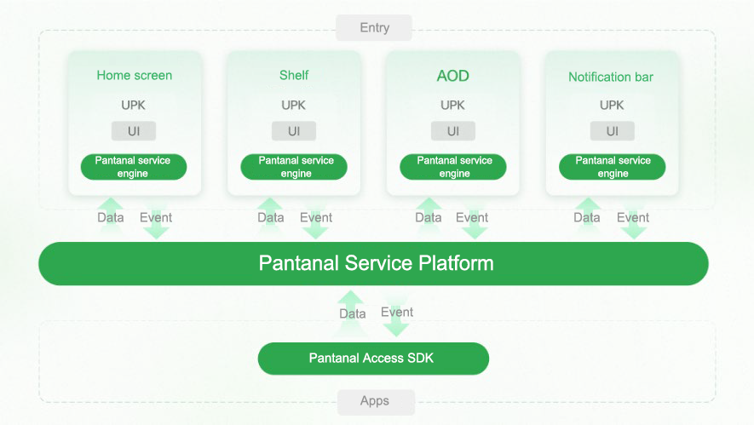
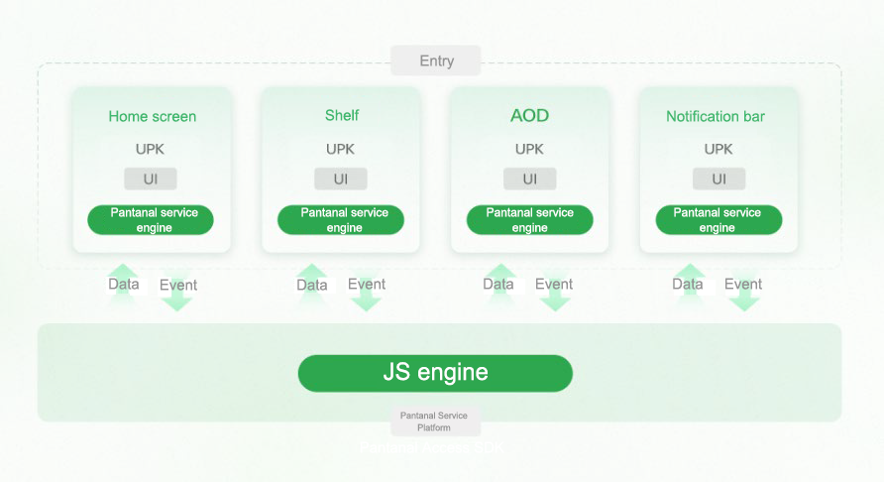
Service development framework - Card development paradigm
App-dependent cards
Display information on multiple entries
Source data from apps integrated with the Pantanal SDK
Pass events to apps through the Pantanal Service Platform
App-independent cards
Run independently without relying on native apps
Source data via backend JavaScript logic
Pass events to backend JavaScript through the Pantanal Service Platform

Slide 15
Part 3 / Development Tools

Slide 16
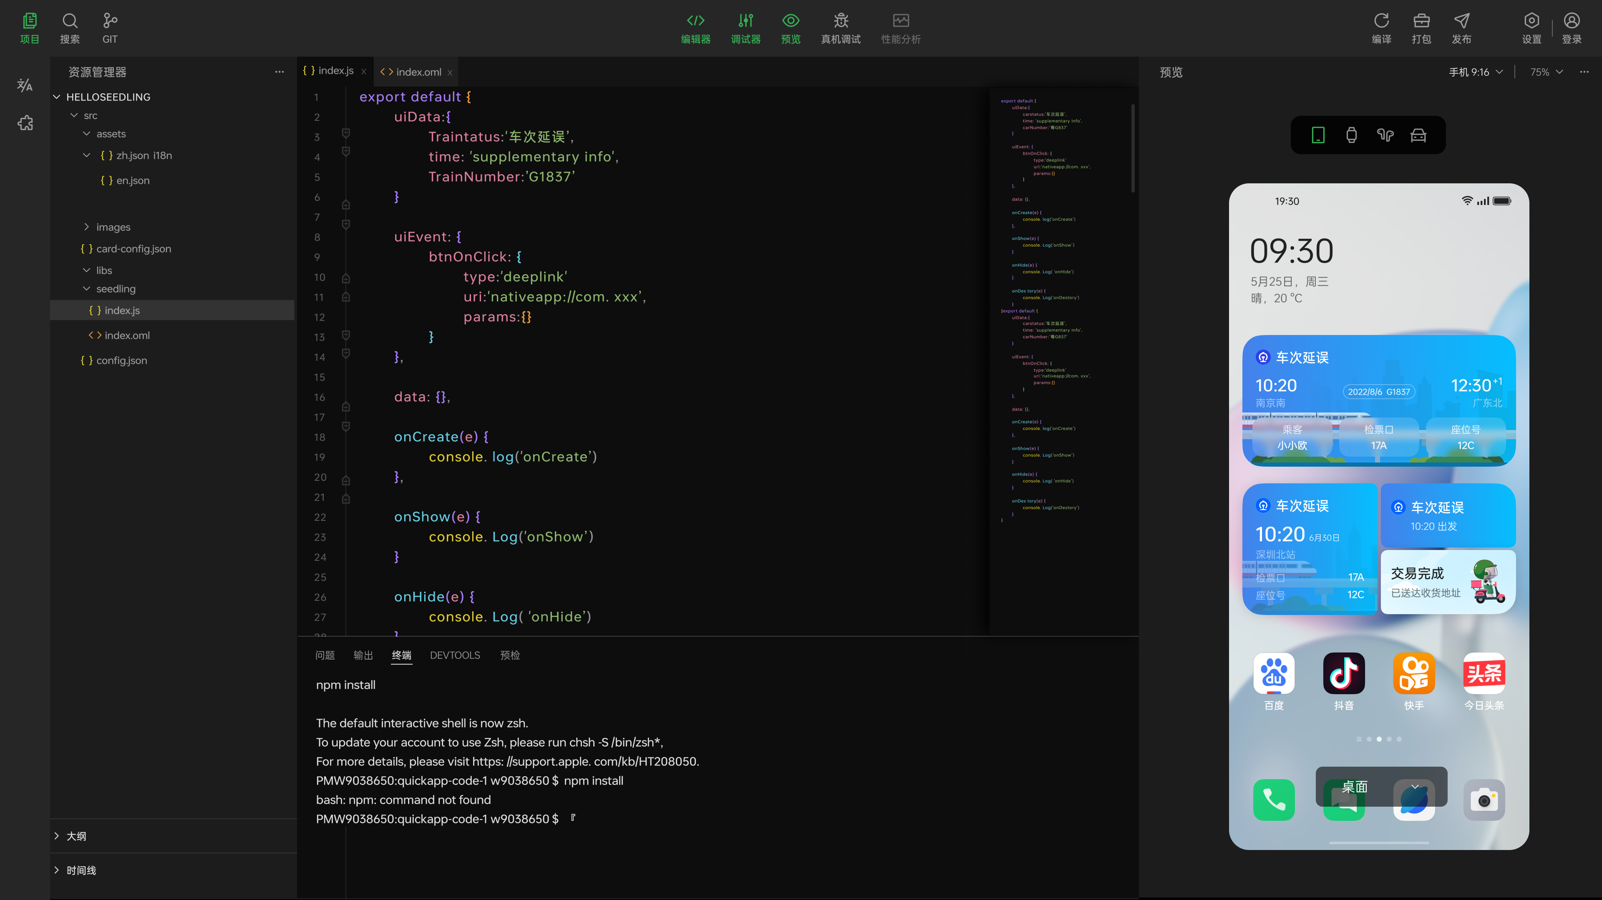
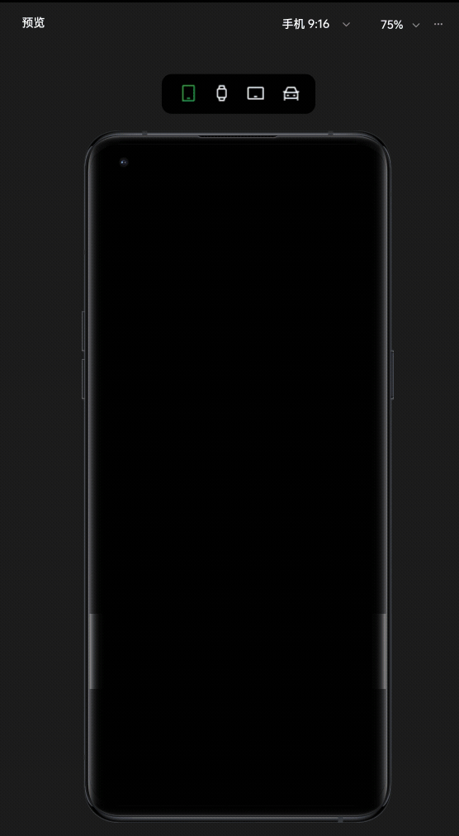
Service development tool: Pantanal DevStudio
Provides developers with a one-stop Pantanal service development environment for improved efficiency
Core functions
Project creation
Code editing
Template selection
Real-time preview
Debugging on real devices
Packaging and signing

Slide 17
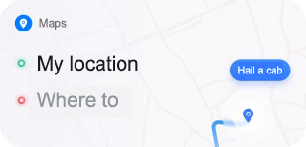
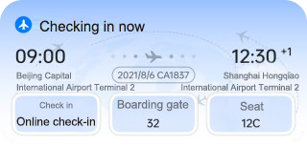
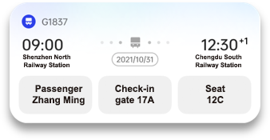
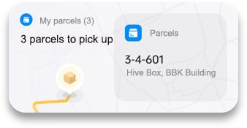
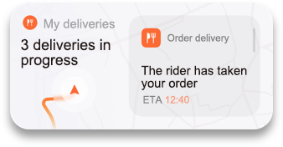
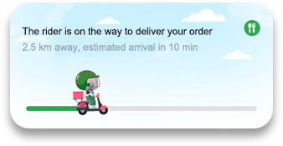
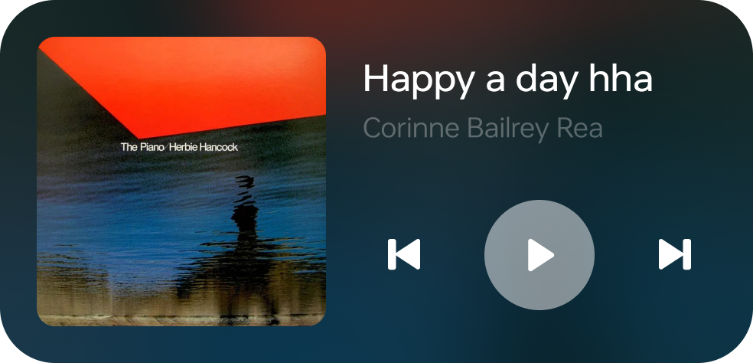
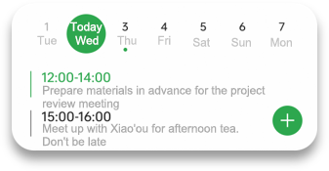
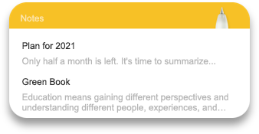
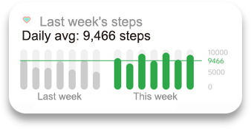
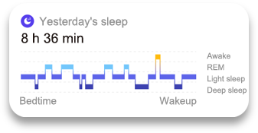
Service development tool: Pantanal DevStudio
Offers a wide range of templates for various scenarios to reduce development costs
Templates for over 20 scenarios

Slide 18
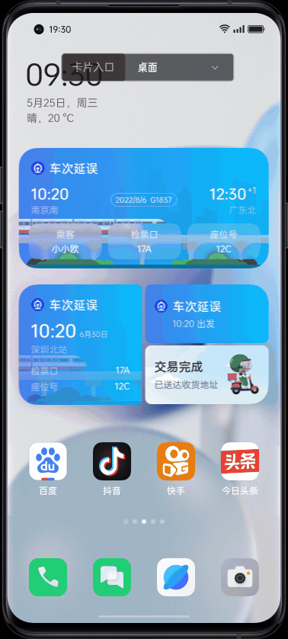
Service development tool: Pantanal DevStudio
Offers real-time preview, enabling developers to quickly obtain and validate results
Core functions
Consistent rendering across platforms
Real-time preview across entries
Real-time preview across devices

Slide 19
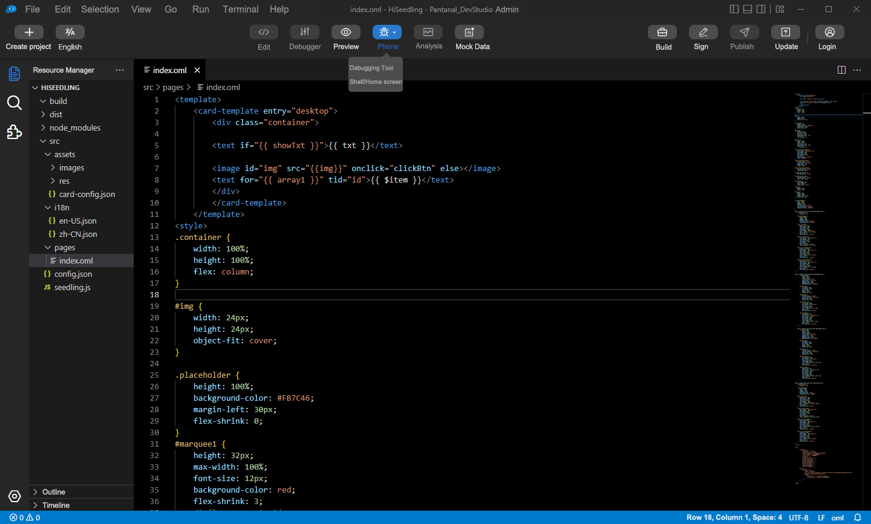
Service development tool: Pantanal DevStudio
Allows developers to debug their apps on real devices, ensuring real-world performance
Core functions
Connection to and debugging on real devices
Real-world performance
Adaptation to multiple entries across devices

Slide 20
Together, we break boundaries

